Slide 1
GIS-based modeling of dynamic landscape processes
Multidimensional Geospatial Modeling:
Lecture notes
Helena Mitasova, NCSU MEAS

Slide 2
Geospatial modeling of processes
Numerical simulations:
tools for gaining new knowledge - virtual experiments
decision-making support
Models of Earth processes have are evolved
from: empirical, spatially averaged, static – still important as “reduced complexity models”
to: process-based, distributed, dynamic with the aim to predict modeled quantity at any point in space and time
results are time series of 2D or 3D data
Notes:
Intro - this has been already covered

Slide 3
Geospatial modeling of processes
Mass flow, fluxes, spread:
air, water, sediment, debris, chemicals, fire, seeds, disease
modeled by continuity and momentum equations
flow / drift + diffusion + proliferation / decay
Energy exchange:
solar, thermal
Biological and anthropogenic systems
Earth Systems Modeling: complex multiscale problem
GIS provides data processing, analysis, visualization and selected simulation tools
Notes:
Intro - this has been already covered

Slide 4
Open Source Earth Modeling
Examples of Open Source Earth processes modeling initiatives
Open Earth: Marine and Coastal science
http://publicwiki.deltares.nl/display/OET/OpenEarth
Community Surface Dynamics Modeling System: Terrestrial, Coastal, Marine, Hydrology, Carbonate, Climate, Fire, Ecosystems
http://csdms.colorado.edu/wiki/Main_Page
Notes:
Intro - this has been already covered

Slide 5
Dynamic Modeling in GIS
Models coupled through
data exchange
user interface – extensions
fully integrated
Models fully integrated in GIS as modules:
solar radiation
spread: flooding, fire
surface runoff water and sediment flow
water flow due to dam break
groundwater flow and pollutant transport

Slide 6
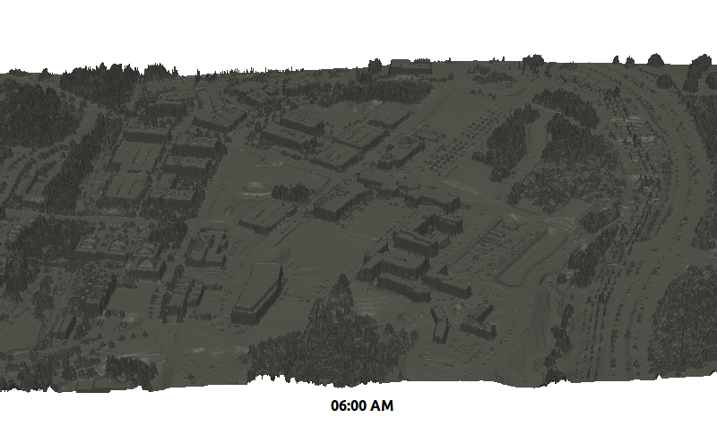
Solar radiation: daily dynamics
Winter: r.sun.hourly
add equation
http://geospatial.ncsu.edu/osgeorel/foss4g-2014-spatio-temporal-visualization.html

Slide 7
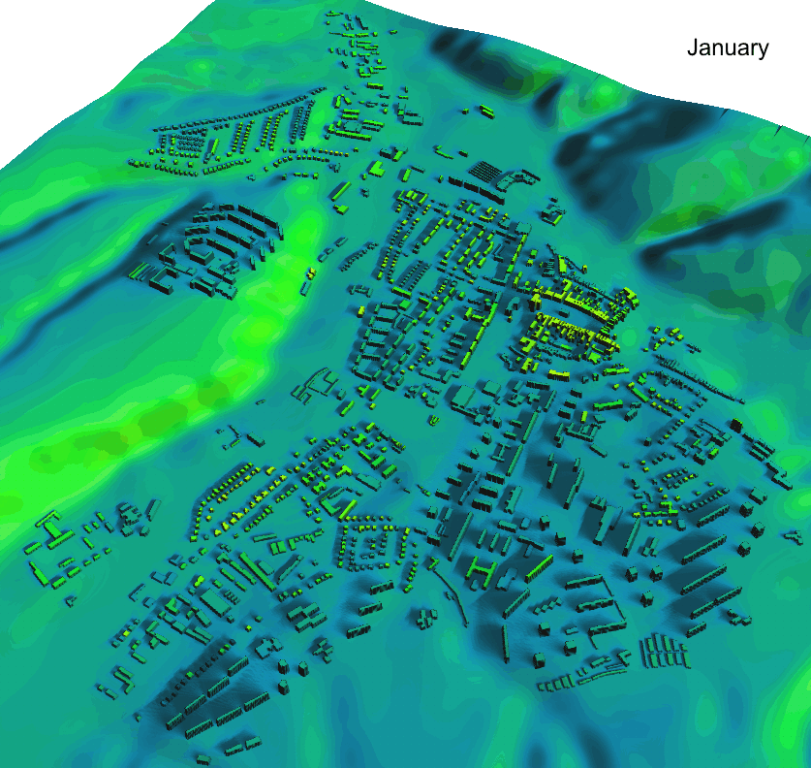
Solar radiation annual dynamics
Application of r.sun in urban areas with 3-D city models: cost/revenue analysis for solar panels, building design, thermal conditions
r.sun.daily
kWh/m²
Jaro Hofierka
University of Presov

Slide 8
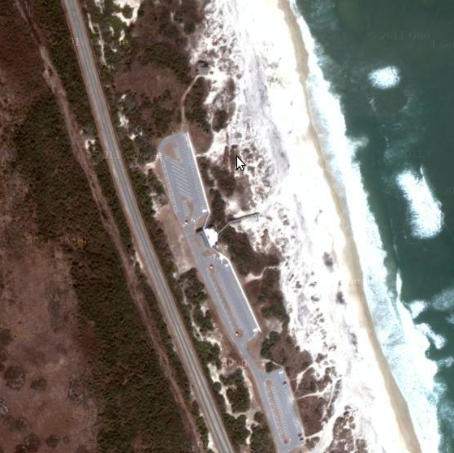
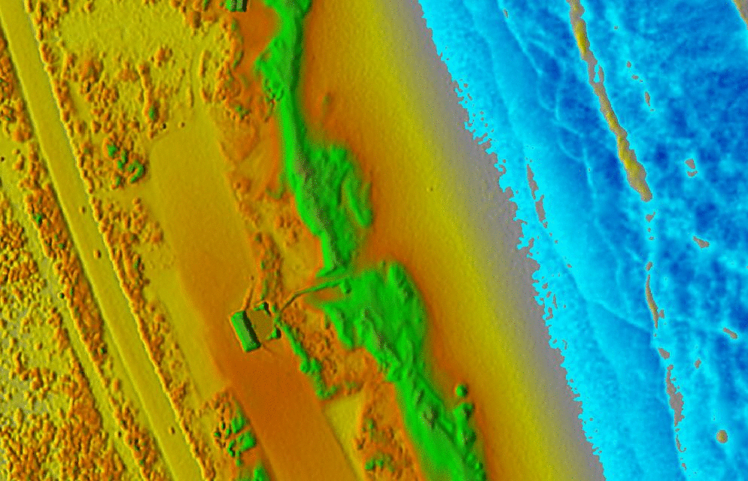
Flood spread
Simple identification of vulnerable locations
Simplified model: spreads water level from a given seed point:
steady state infinite water supply

Slide 9
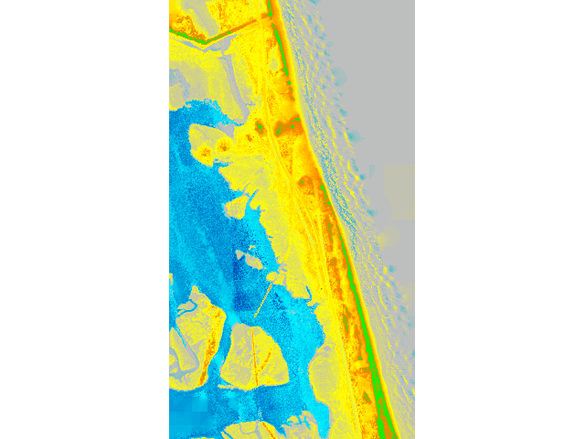
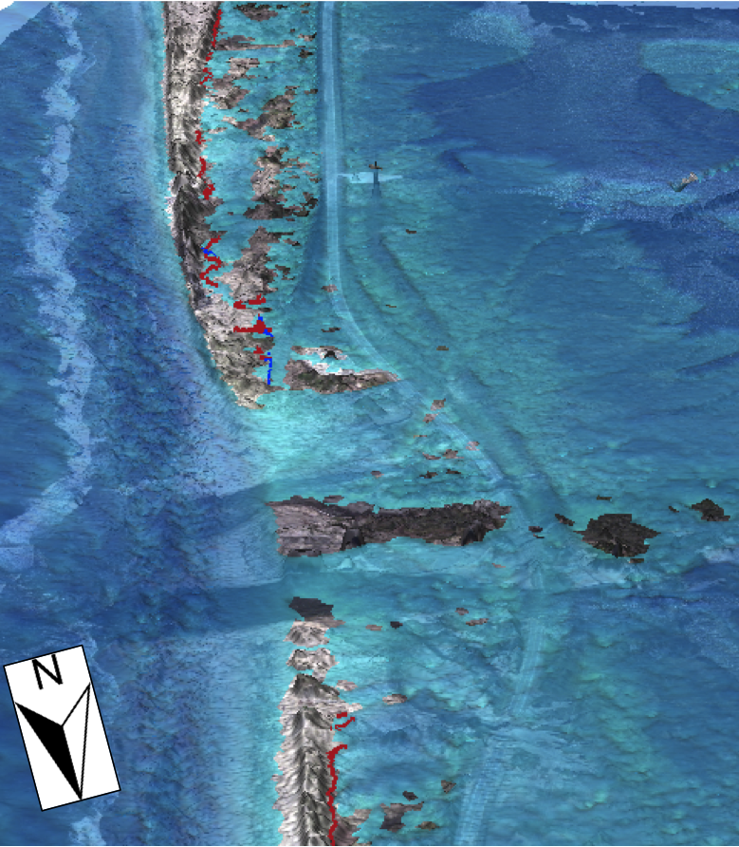
Flood spread
Reconstruction of Pea Island flooding during hurricane Irene Emily Russ MS thesis

Slide 10
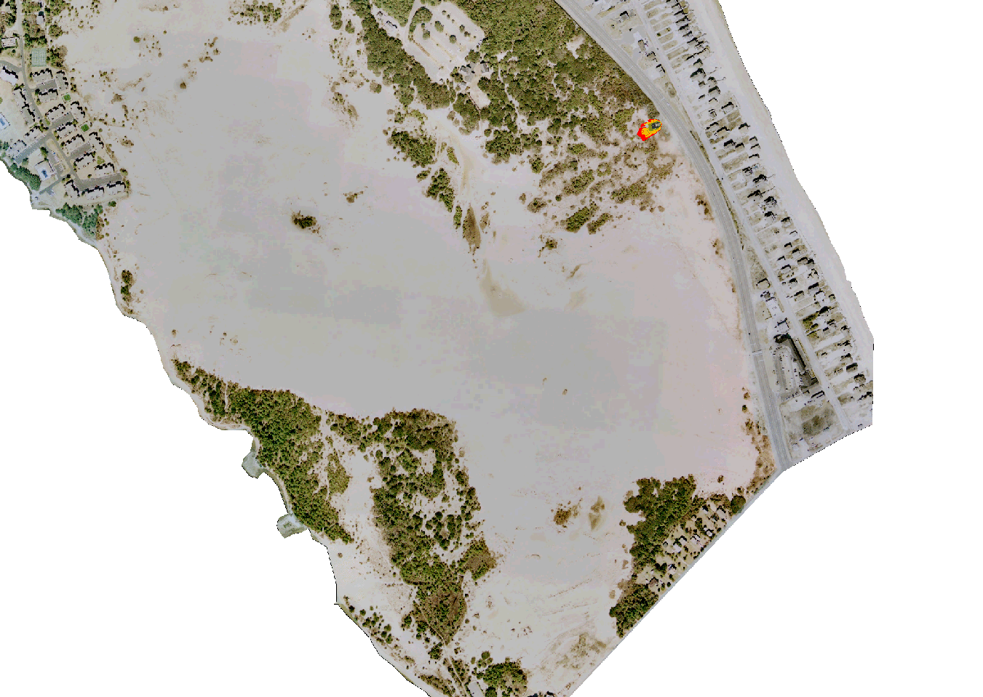
Fire spread
least cost path spread over cost surface based on fuel availability and wind field
http://geospatial.ncsu.edu/osgeorel/fire-spread.html
http://geospatial.ncsu.edu/osgeorel/foss4g-2014-spatio-temporal-visualization.html

Slide 11
Hydrologic modeling
Watershed and stream network analysis, flow pattern mapping – derived from DEM
Hydrologic modeling – physics based flow routing

Slide 12
Watershed and flooding analysis
Steady state, geometry based,
focused on features extraction and spatial patterns
Flow tracing and watershed analysis:
r.watershed: D8, SFD, shortest path
r.stream.extract: ordered stream network
r.stream * add ons
r.flow: Dinf, SFD
r.terraflow: D8, SFD/MFD
r.carve
Wetness index, flood extent
r.topinx, mapalgebra + r.watershed + r.slope.aspect
r.lake

Slide 13
Hydrologic modeling
Process-based modeling - PDE solvers:
r.sim.water: process based hydrologic simulation
r.sim.sediment: sediment transport, erosion/deposition
r.dambreak
r.gwflow
r.solute.transp
Older modules:
r.topmodel: hydrologic simulation with subsurface flow
r.water.fea: hydrologic simulation, kinematic wave
r.hydro.casc2d: hydrologic simulation, diffusive wave, evolved into stand alone model GEISHA
non-point source pollution: ANSWERS, AGNPS, SWAT

Slide 14
Overland water flow – governing equations
Shallow overland flow – bivariate St. Venant equation:
steady state kinematic wave with approx. diffusive wave effect
r=(x,y)[m],
h – water depth [m], approximated by flowaccumulation
i_{e} – rainfall excess rate [m/s],
v - velocity given by Mannings eq. [m/s], v=f(h,slp)
 - diffusion constant
the diffusion term (dependent on h^{5/3}) makes the equation linear in h^{5/3}
making it possible to solve it by path sampling method.

Slide 15
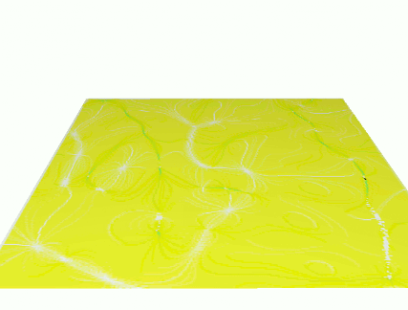
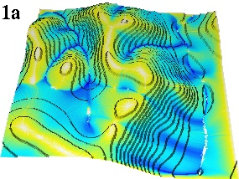
Water flow over complex terrain
Simple, kinematic wave overland water flow simulation for uniform rainfall, soil and cover conditions. Created by customized version of r.flow by writing output flowline densities after passing given number of cells.
Depressions are handled as sinks.

Slide 16
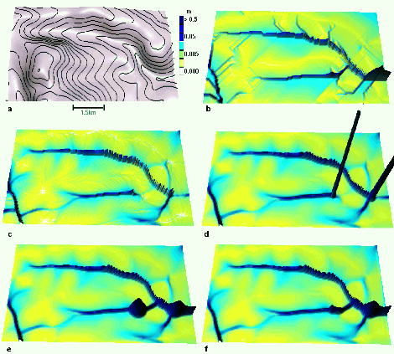
Flow modeling
Moves water along gradient
Steady state water flow
b ) flow accumulation by D8, passes through depression as least cost path
c) flow acumulation by D-inf, depression is a sink
d) kinematic wave - water accumulates in the sink
e) diffusion term allows water to pass through depression
f) channel defined through depression as preferential flow
c), d) require hydrologically conditioned DEM
Notes:
Intro - this has been already covered

Slide 17
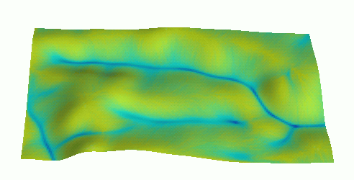
Water flow modelling
dynamic model: diffusive wave - passes through depressions, updates water levels
approximate diffusive wave - adds diffusion term that increases when water starts to accumulate in depression
Notes:
Intro - this has been already covered

Slide 18
Particles ⬄ Fields
in geospatial simulations the physical quantities depend on position in space and can be represented by
fields - continuous distribution (scalar, vector, tensor) particles - discrete distribution
Transformation between the two representations:
distributed particles > particle density function > field f (r)
field f (r) > sampling with density f(r) > particle representation
Process can be modeled as
evolution of fields
evolution of spatially distributed particles
Path sampling method uses this duality to solve the governing equations
Notes:
Intro - this has been already covered

Slide 19
Path (particle) sampling method
Method for solving linear partial differential equations developed in physics, used also in chemistry, finance, and other disciplines.
Governing equation: L(c) = S
S is sources-sinks, c is the modeled quantity,
L is the operator
e.g., flow/drift + diffusion + proliferation/decay
Solution: c = L ⁻¹ (S)
L⁻¹ is the inverse operator
sample the source term field > simulate action of L⁻¹ on S estimate c from the density
Notes:
Intro - this has been already covered

Slide 20
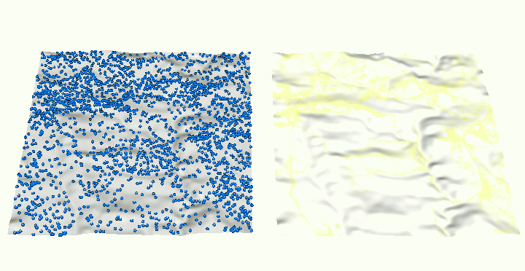
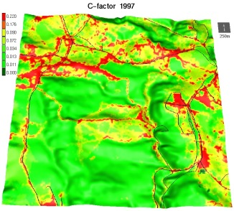
Path sampling
- based on duality between particle and field representation - path samples represent water evolving according to the shallow water bivariate continuity equation - drift and diffusion
Land cover:
red - disturbed areas
green - forest
Water depth: particles (1% shown) continuous field=particle density
Rainfall excess, land cover and topography are spatially variable

Slide 21
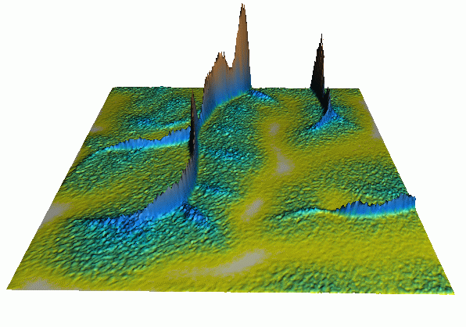
Path sampling accuracy, properties
Error is proportional to the 1/N^{0.5}, where N is the number of samples
N = 70,000 (~1 per cell) 50 million (50K run on 1000 processors)
Properties:
no mesh is needed (can be used with standard GIS formats)
computationally demanding but perfectly scalable for parallel architectures
robust and flexible: multidimensional, multiscale, spatially variable

Slide 22
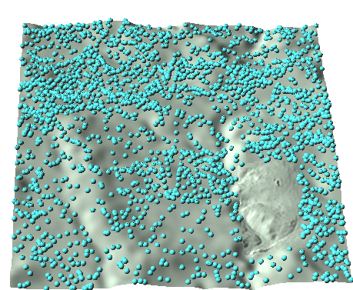
Multiscale simulations
Simulation of overland water flow:
10m resolution combined with 2m resolution
particles are split when they enter highn resolution area

Slide 23
Modeling erosion and sediment flow
Motivation: sustainable land use management
- analysis of spatial pattern of sediment flow,
- identification sediment sources and sinks,
- design of conservation measures

Slide 24
Sediment transport
Sediment transport and net erosion/deposition model is based
on 2D generalization of a 1D hillslope erosion model used in WEPP.
Using steady state water flow as input sediment transport is described
by continuity equation with diffusion term:
where D = s ( T - q_{s} ) is sources-sinks term
D / D_{c} + q_{s} / T = 1 (Foster and Meyer, 1972)
T = K_{t} ^{p}
D_{c} = K_{d} ( - _{c})^{q}
c - sediment concentration, q_{s} - sediment flow,
T - transport capacity, D_{c}- detachment capacity, s(r) - first order reaction coef.
 – diffusion constant,  - shear stress, _{c} - critical shear stress,
K_{t,} K_{d} - transport and detachment capacity coef.

Slide 25
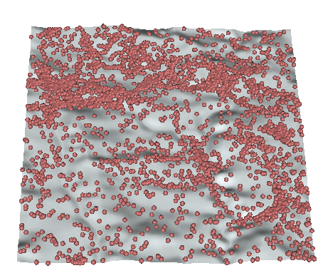
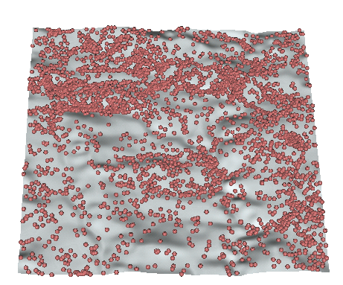
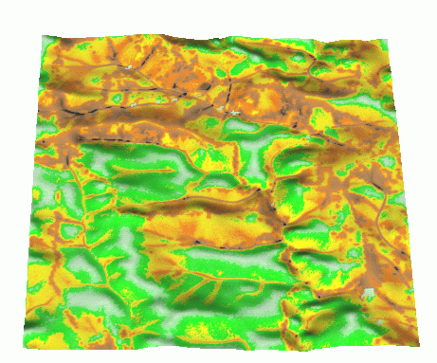
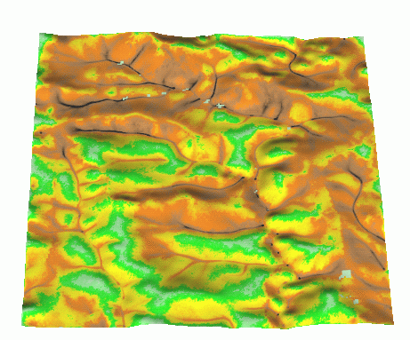
Sediment flow for different soils
sand C ~1 clay C ~0.1
transport
capacity
limited case
TCL
detachment
capacity
limited case
DCL

Slide 26
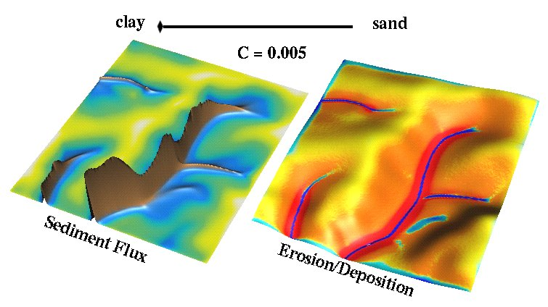
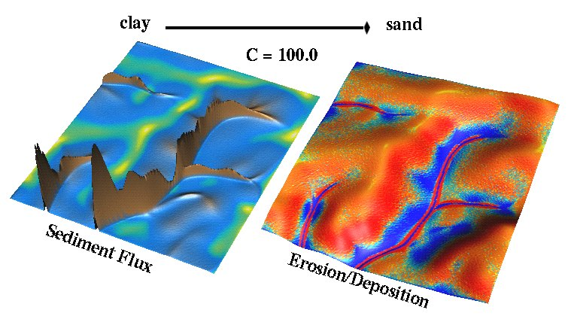
Detachment and transport capacity limited
transport capacity of surface water flow is much higher than its capacity
to detach soil (e.g. due to soil compaction) >
erosion everywhere
transport capacity of surface water flow is lower > deposition starts
higher on hillslopes

Slide 27
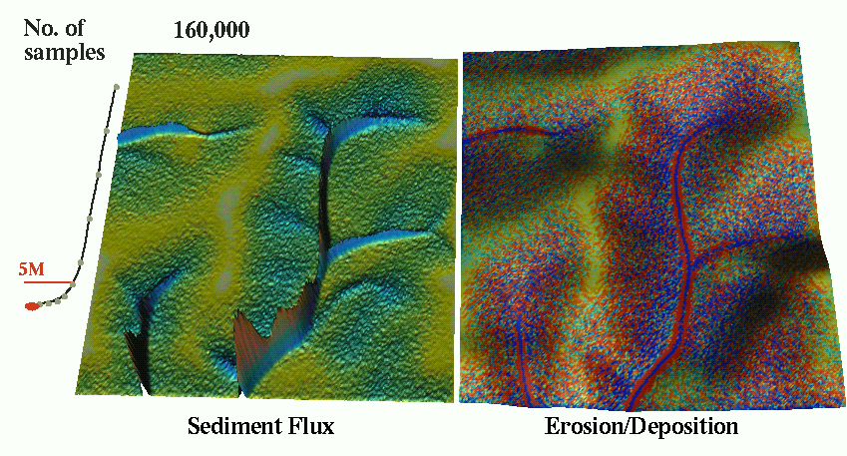
Path sampling accuracy
Net erosion/deposition as change in sediment flow
sediment flow computed using path sampling
accuracy depends on the number of particles used in simulation
Notes:
Intro - this has been already covered

Slide 28
Implementation in GRASS and Applications
Implemented in GRASS as r.sim.water and r.sim.sediment
Released with GRASS5.3 as experimental code
Applications focus on spatial pattern of water and sediment
flow and net erosion/deposition under spatially variable
conditions:
- studies of land use change impact,
- design of conservation measures.
H. Mitasova

Slide 29
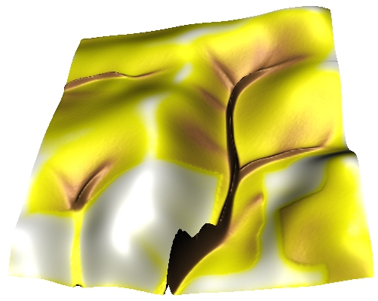
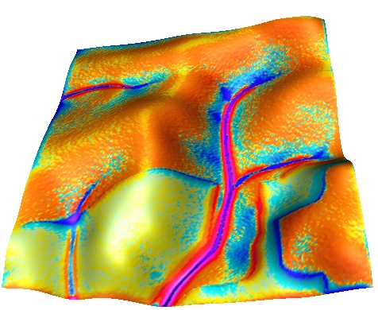
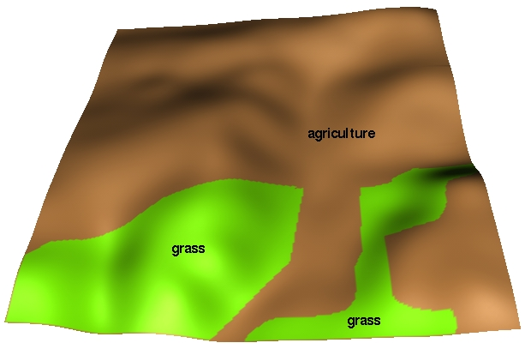
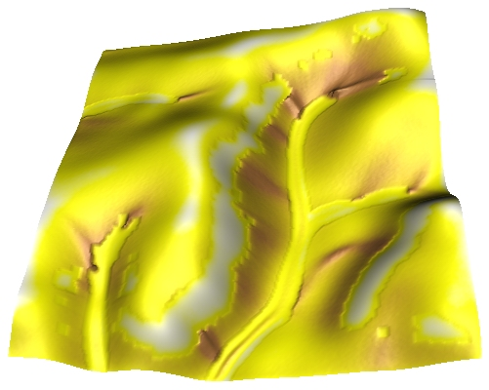
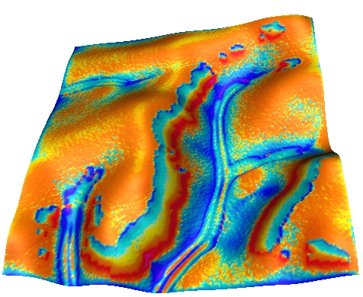
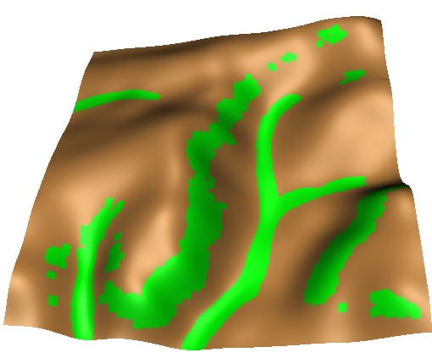
Impact of change in land use pattern
Original LU sediment flow net erosion/deposition
Optimized LU: estimate erosion for uniform bare ground
and put grass on the highest erosion areas

Slide 30
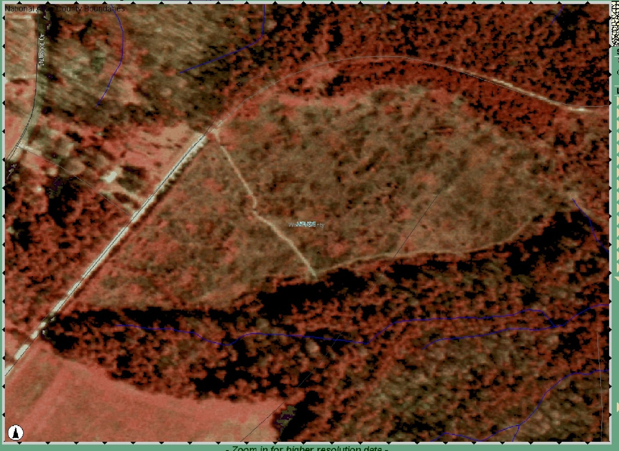
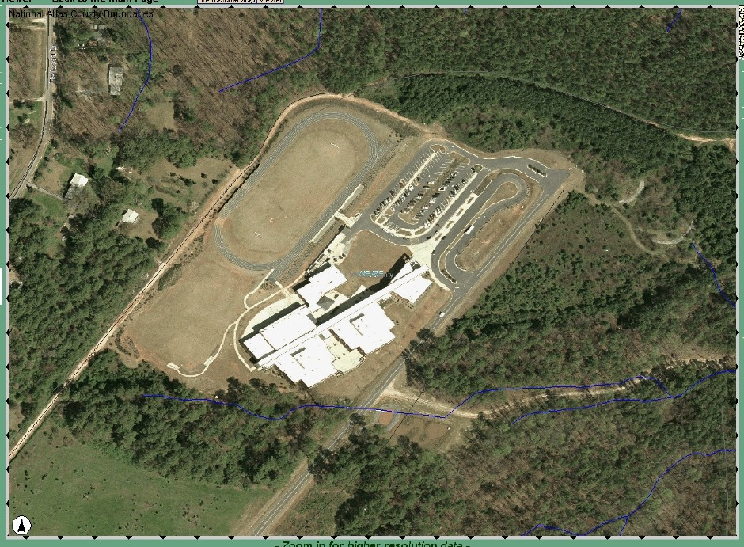
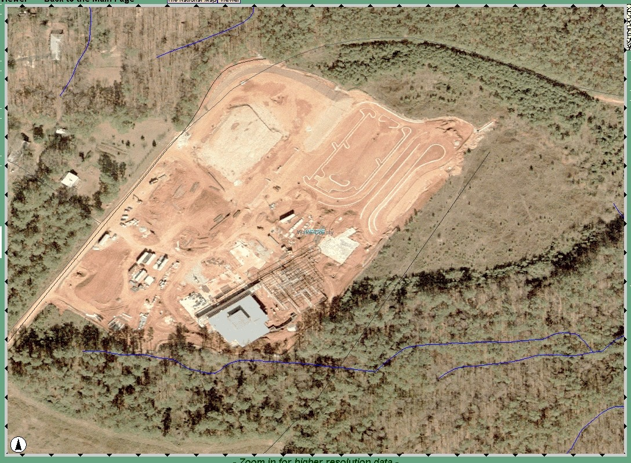
Impact of development
Construction and development
changes land cover and topography
Regulations mandate storm water
and sediment control

Slide 31
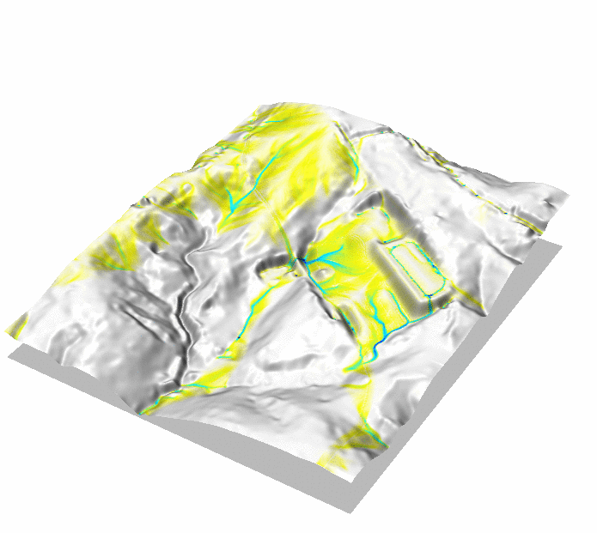
Overland flow simulation
Centennial Campus Middle school: bare earth model
Notes:
Intro - this has been already covered

Slide 32
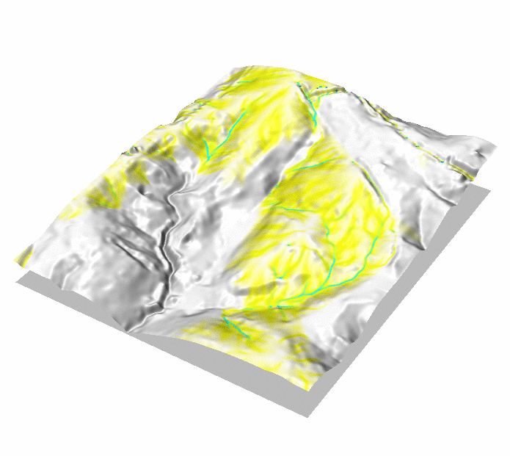
Overland flow simulation
Change in topography and land cover: 1993 and 2001 conditions
Notes:
Intro - this has been already covered

Slide 33
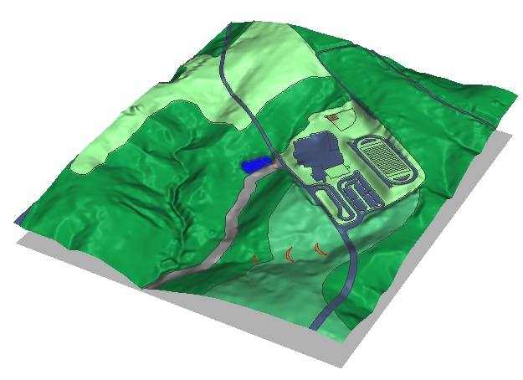
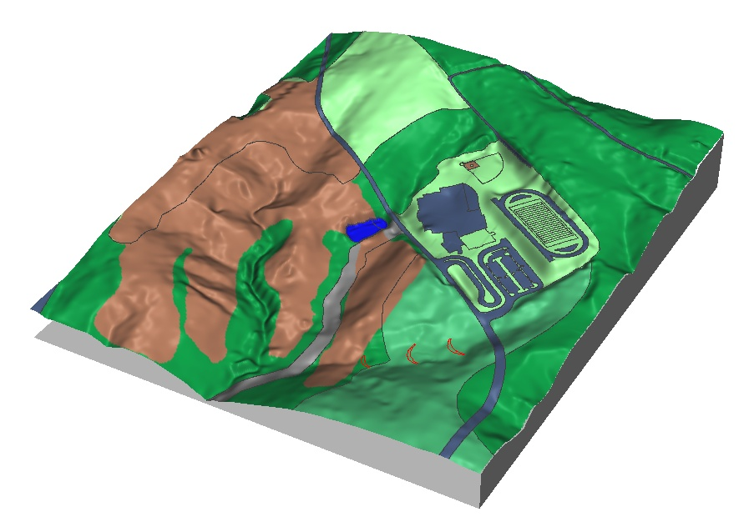
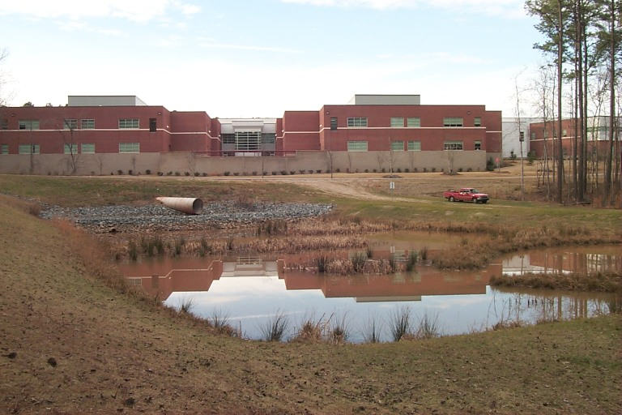
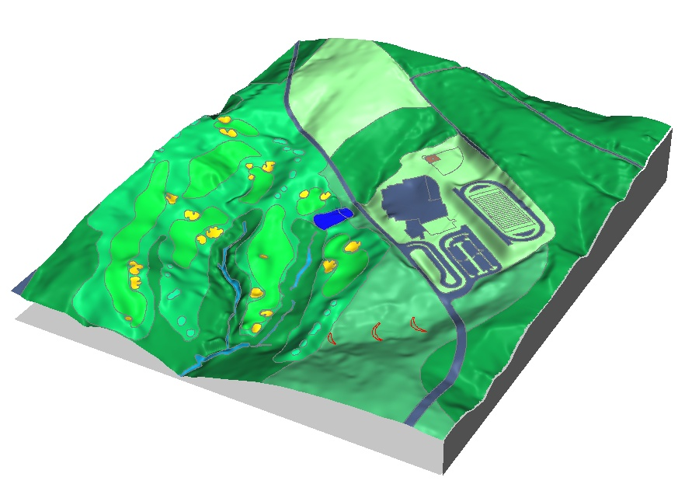
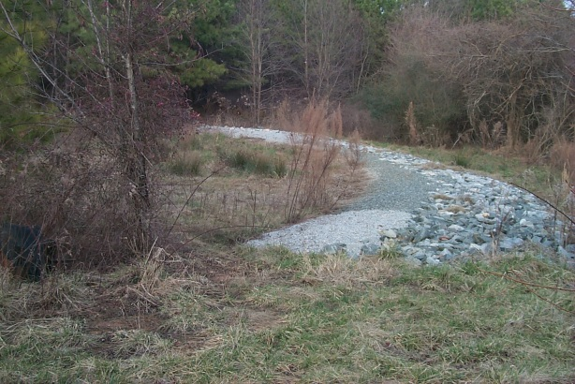
Impact of development
Create GIS representation of land use as input for modeling
post-construction
with storm water
control measures
golf course
Notes:
Intro - this has been already covered

Slide 34
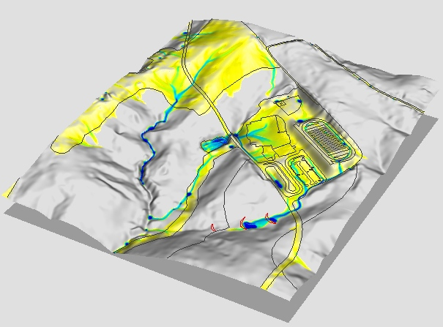
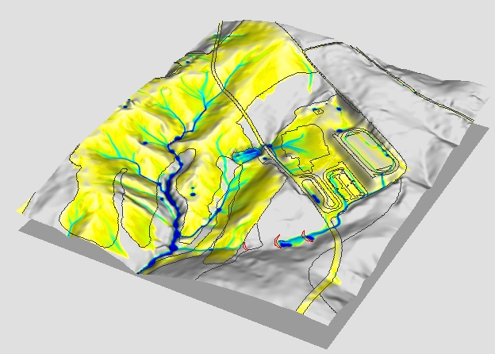
Landcover impact on water flow
current
49% forest
construction
24% forest
0.002m³/s
0.7m³/s
discharge m³/s
Spatial distribution of water discharge for 1hr steady rainfall at 46mm/hr (2 year design storm)

Slide 35
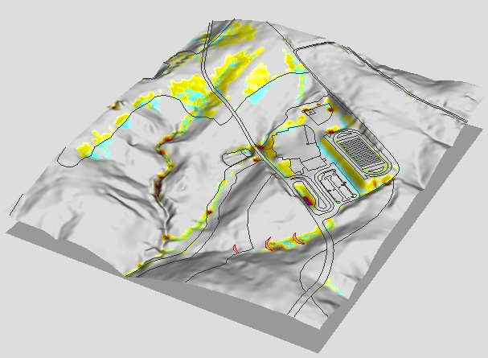
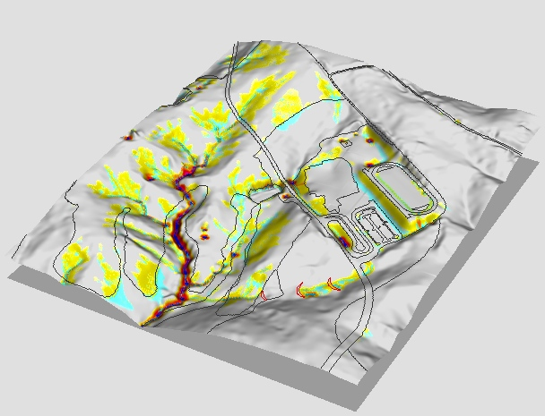
Net erosion/deposition change
main impact of disturbance is
outside construction site:
stream erosion within protective buffer
0.001kg/ms
erosion=87kg/s
0.01-6.0kg/ms
erosion=968kg/s
erosion
deposition
/m²s
erosion
deposition

Slide 36
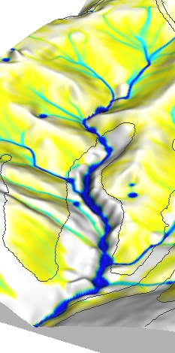
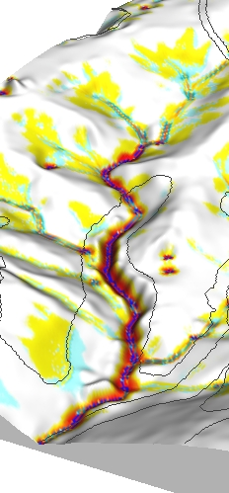
Net erosion/deposition within buffer
impact of disturbance caused by concentrated water flow
that is not sufficiently reduced by the buffer,
maximum erosion rates are within the protective buffer
Discharge m³/s
/m²s
Erosion
deposition

Slide 37
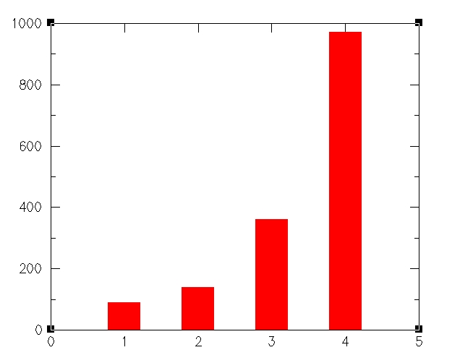
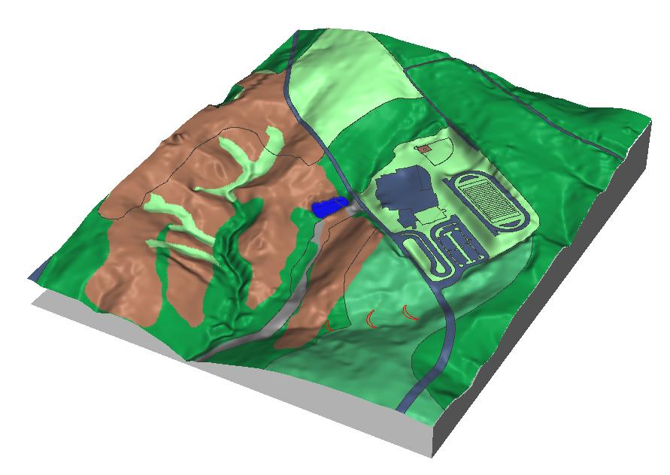
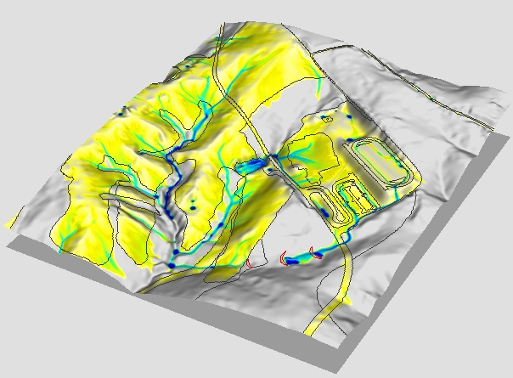
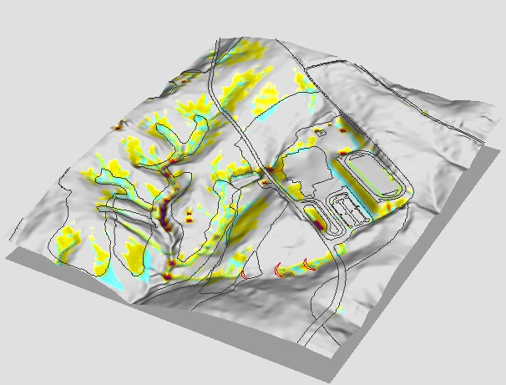
Net erosion/deposition: extended buffers
total erosion kg/s
Extended,
high infiltration
buffers can reduce
the impact
current
forest
buffer
grass
buffer
no extended buffer

Slide 38
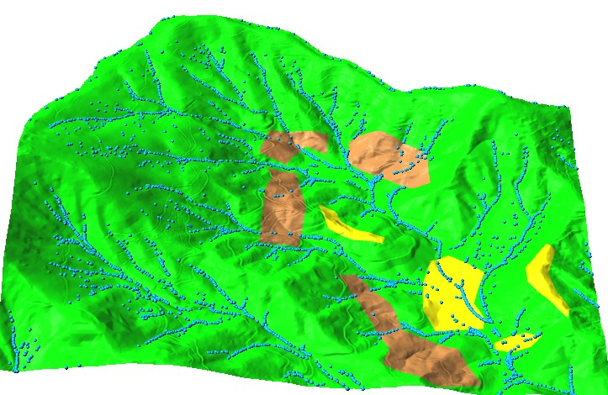
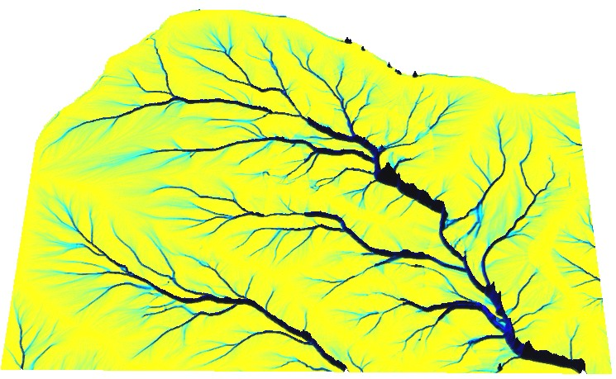
Hydrologic Modelling
impact of golf course at Balsam mountain development
Notes:
Intro - this has been already covered

Slide 39
Hydrologic Modelling
impact of golf course at Balsam mountain development
Notes:
Intro - this has been already covered

Slide 40
Hydrologic Modeling
Subsurface drainage planning for a corn field
4 and 48 hrs after rainfall with and without drainage
Notes:
Intro - this has been already covered

Slide 41
Conclusions
New generation of models:
physical/bio/eco laws and principles
seamless between continuous and discrete
New types of methods:
path sampling Monte Carlo
robustness, scalability, efficient for high-D distributed problems
Beyond single scale:
multi-resolution, multi-process
Challenges:
nested models -> information reduction
computational ("integrate the codes")
nonlinearities, unstable systems

Slide 42
Designing with nature
Motivation: sustainable land use management
- analysis of spatial pattern of sediment flow,
- identification sediment sources and sinks,
design of conservation measures
Sand motor
http://www.dezandmotor.nl/en-GB/
http://www.dezandmotor.nl/en-GB/the-sand-motor/photos-and-pictures/
Terracing with hedges

Slide 43
Modeling impact of hedges
slope
elevation at pins
1996
1993
erosion
deposition
Seth M. Dabney et al. 1999
Lanscape Benching from Tillage Erosion Between Grass Hedges

Slide 44
Evolution of hedge slope without tillage
Evolution of erosion and deposition pattern
growing impact of small artifact
Seth M. Dabney et al. 1999 Lanscape Benching from Tillage Erosion Between Grass Hedges

Slide 45
Dynamics of erosion/deposition pattern

